Slide 1

EEE415 ASSIGNMENT
4 BIT PC DESIGN WITH VERILOG
Prepared by
Md Maisoon Rahman
Id: 1606038

Slide 2
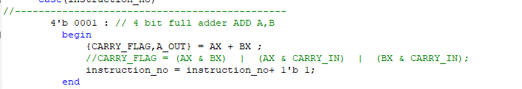
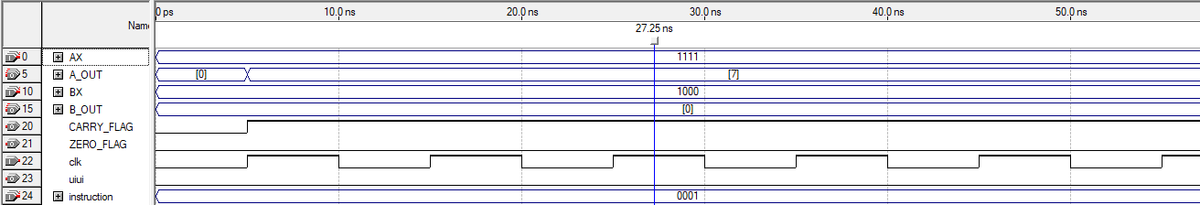
The code snippet for 1. ADD A,B
The OUTPUT WAVE SHAPE

Slide 3
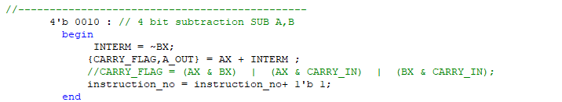
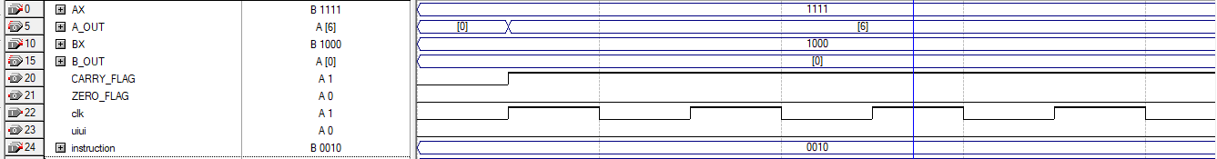
The code snippet for 2. SUB A,B
The OUTPUT WAVE SHAPE

Slide 4
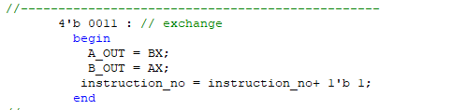
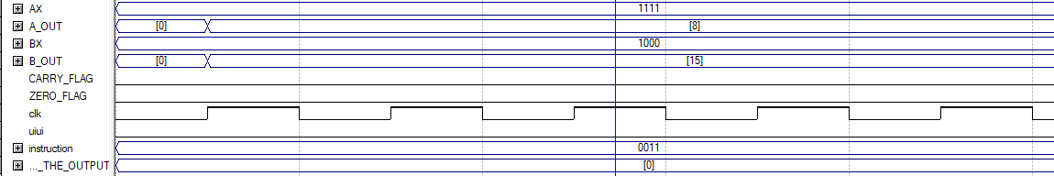
The code snippet for 3. EXC A,B
The OUTPUT WAVE SHAPE

Slide 5
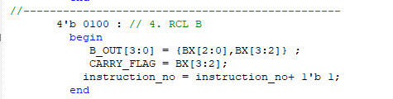
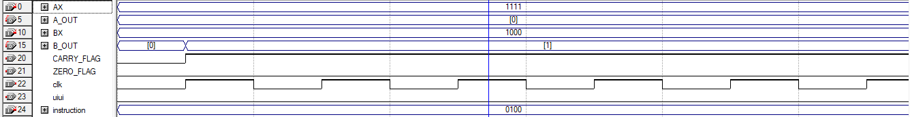
The code snippet for 4. RCL B
The OUTPUT WAVE SHAPE

Slide 6
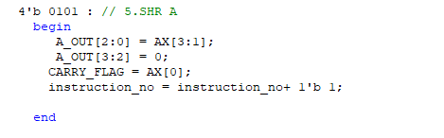
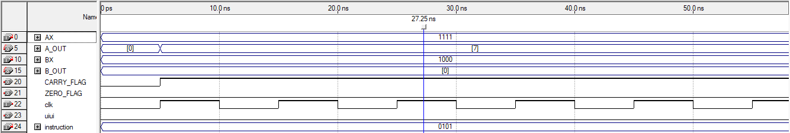
The code snippet for 5. SHR A
The OUTPUT WAVE SHAPE

Slide 7
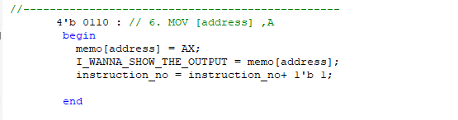
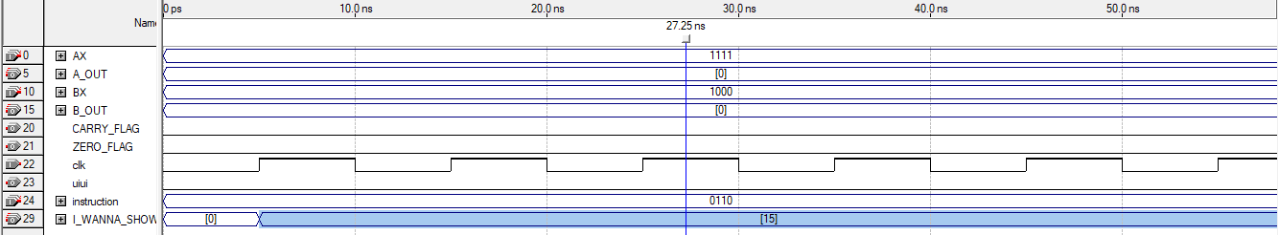
The code snippet for 6. MOV [address, A]
The OUTPUT WAVE SHAPE

Slide 8
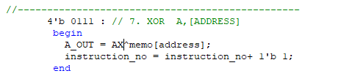
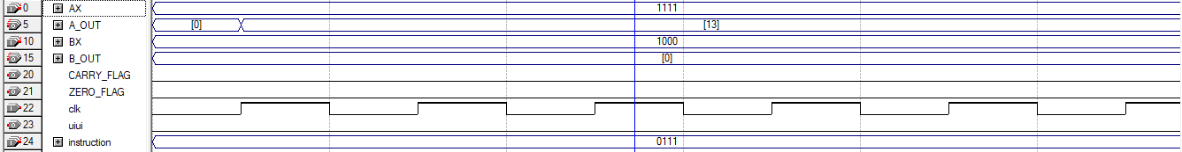
The code snippet for 7. XOR A, [address]
The OUTPUT WAVE SHAPE

Slide 9
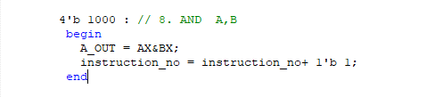
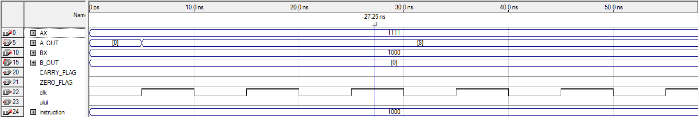
The code snippet for 8. AND A,B
The OUTPUT WAVE SHAPE

Slide 10
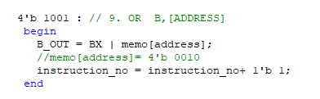
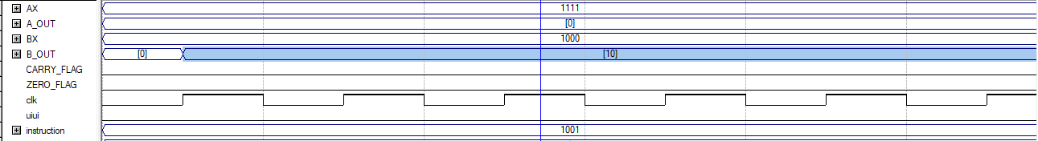
The code snippet for 9. OR B, [ADDRESS]
The OUTPUT WAVE SHAPE

Slide 11
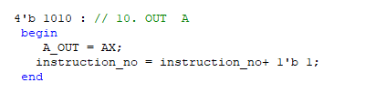
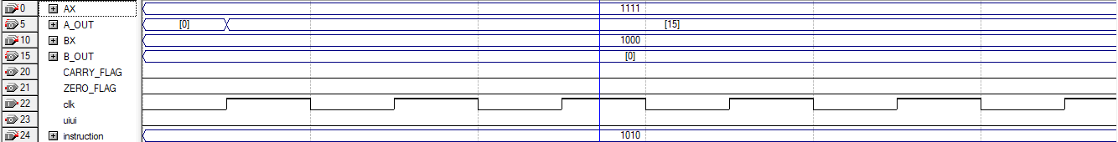
The code snippet for 10. OUT A
The OUTPUT WAVE SHAPE

Slide 12
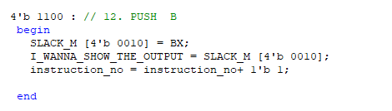
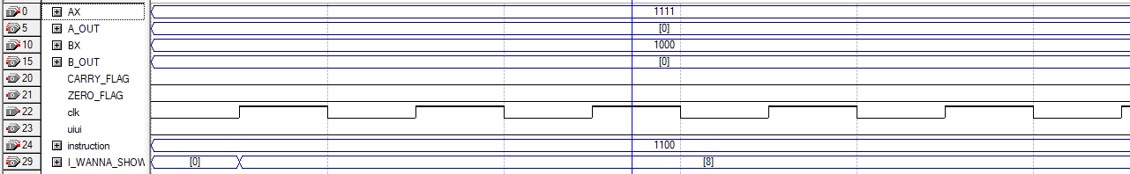
The code snippet for 12. PUSH B
The OUTPUT WAVE SHAPE

Slide 13
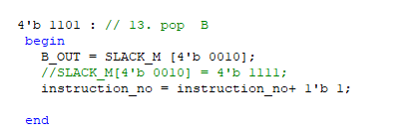
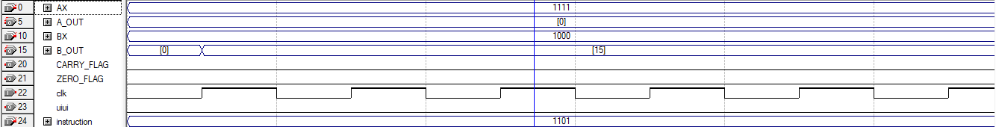
The code snippet for 13. POP B
The OUTPUT WAVE SHAPE

Slide 14
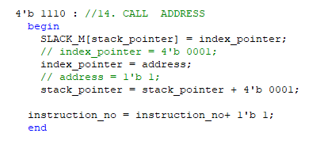
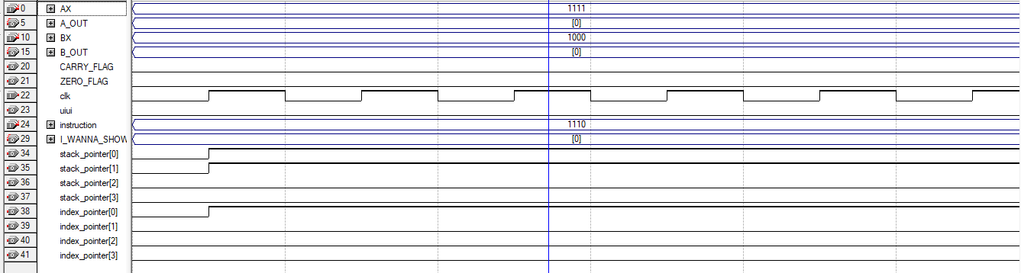
The code snippet for 14. CALL ADDRESS
The OUTPUT WAVE SHAPE

Slide 15
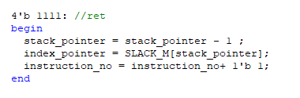
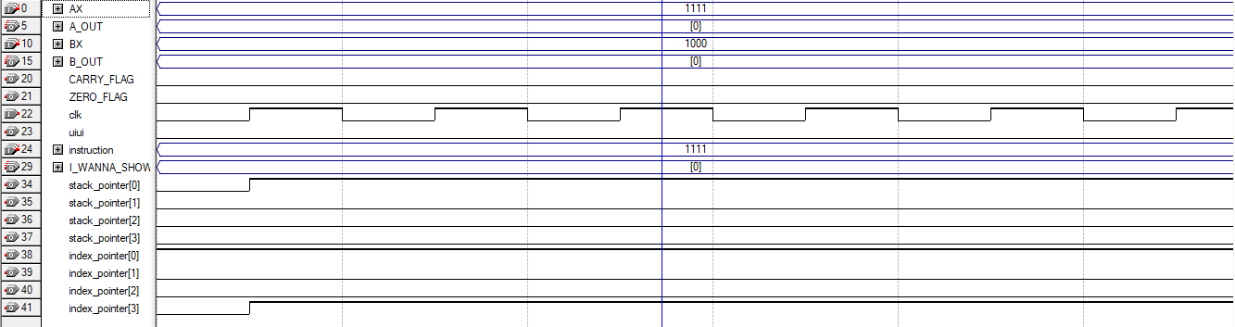
The code snippet for 15. RET
The OUTPUT WAVE SHAPE

Slide 16
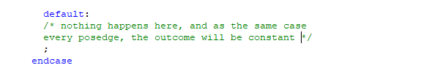
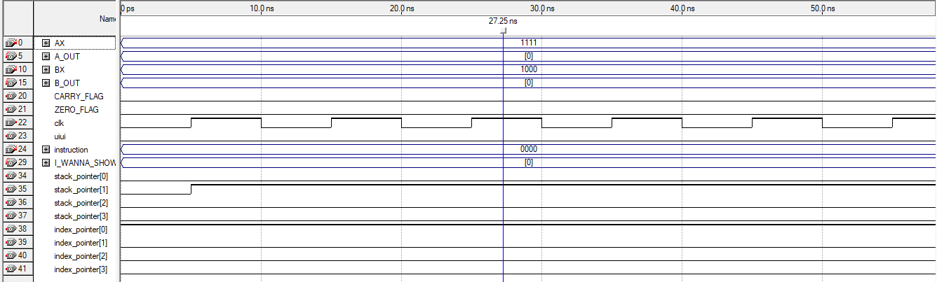
The code snippet for 16. HLT
The OUTPUT WAVE SHAPE

